Slide 1

Fin BluePrint: Retirement Planning
VISHAL DALAL – Certified Financial Planner

Slide 2

Contents
Determine your Retirement Corpus
Determine your Risk Appetite
Determine your Deployment Options

Slide 3
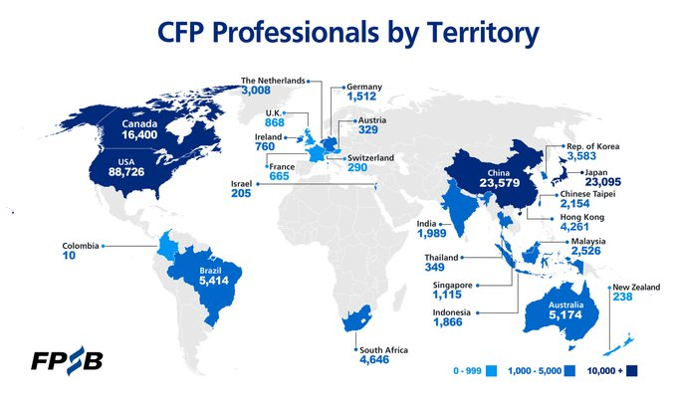
Who are we?
Certified Financial Planner - internationally recognized
24 years corporate experience (17+ in Fortune 500 banks)
Planning to retire soon! ☺

Slide 4
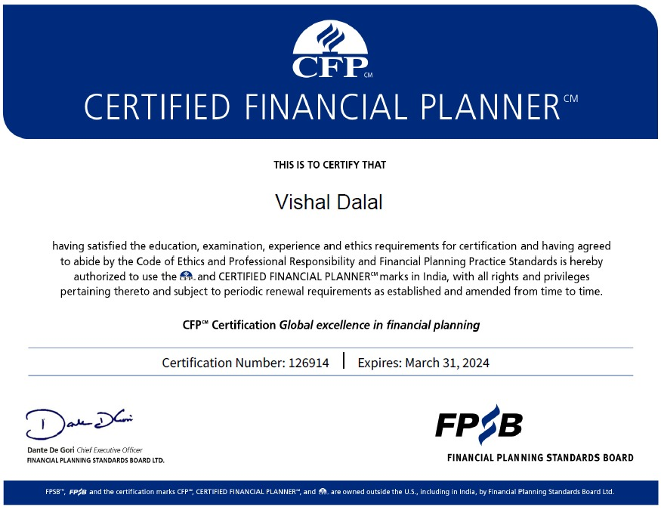

Slide 5
Determine your Retirement Corpus
Determining Factors
  Current & Future Expenses
    Expected – regular / bulk
    Unexpected / Contingency
  Expected Income – pension, annuity, rental, etc.
  Bequeath to children, family, etc.
  Inflation (Assumption)
  Lifespan / Longevity (Assumption)
  Risk Quotient & Investment of Corpus
  (Debt / Equity / Gold / etc.)

Slide 6
Corpus Determination - Example
Couple | Both aged 60 years
Current & Projected Expenses @ age 60 | Regular: 50,000 / month, increasing with inflation Bulk: Single child’s marriage @ age 65: 35 lakhs
Expected Income | 20,000 pension / month until life, increasing with inflation
Bequeath to children / family | Existing premises
Inflation | Assumed @ 6% until lifetime
Liespan / Longetivity | Assumed up to 80 years
Risk Quotient & Investment of Corpus | Moderate Allocation: 50% Debt, 30% Equity, 20% Gold

Slide 7
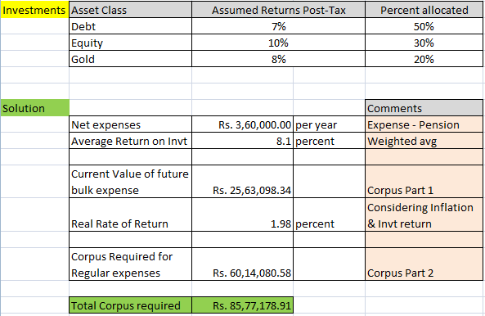
Corpus Determination – Summary Solution

Slide 8
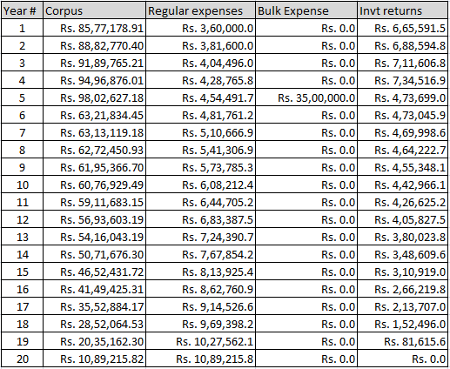
Corpus Determination - Details

Slide 9
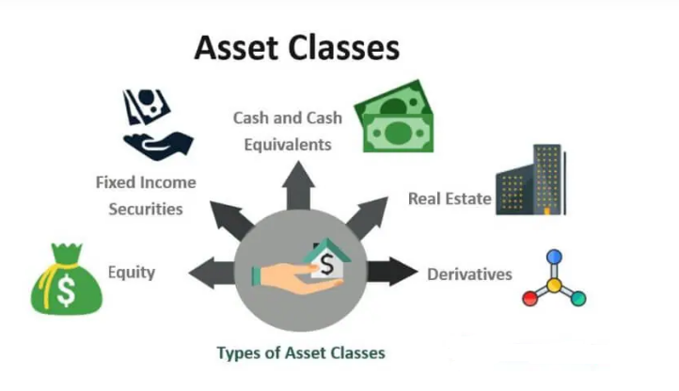

Slide 10
Asset Classes & Products - Debt
Product | Liquidity | Risk | Suitable For | Taxation
Bank Fixed Deposits | H | L | ST | Clubbed with income
Corporate Bonds AAA, AA, Credit-Risk | L | L / M / H Per Ratings & Duration | ST, MT | Clubbed with income
Small Saving Schemes NSC/KVP/PPF/Post-Office | L | L | MT, LT | 80C benefits, EET, EEE
Gov / Mun / RBI Bonds | L | L | MT, LT | Clubbed with income
Mutual Fund Debt, Dynamic Bond, Corp Bond | H | L / M / H | LT | Clubbed with income
ST / MT / LT: Short-Term (<3 yrs) / Medium-Term (3 – 7 yrs) / Long-Term (> 7 yrs)
L / M / H: Low / Medium / High

Slide 11
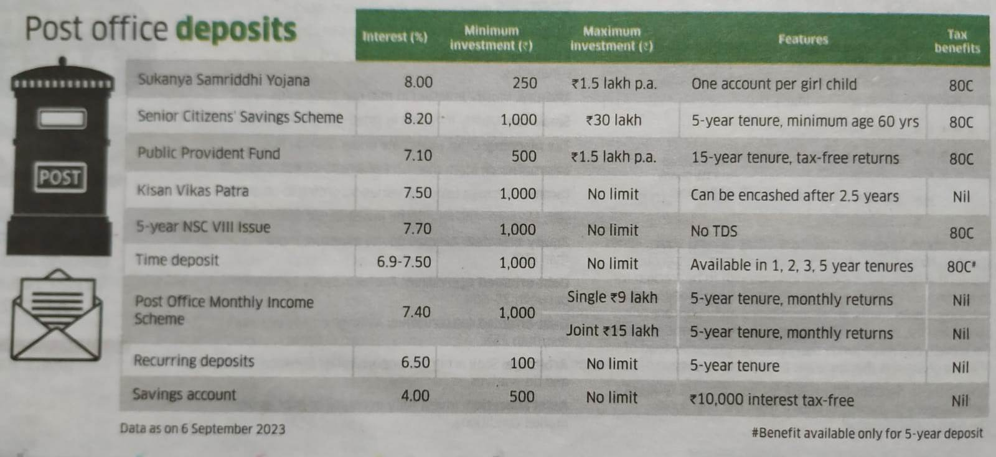
Small Saving Schemes – Current Rates

Slide 12
Asset Classes & Products - Equity
Product | Liquidity | Risk | Suitable For | Taxation
Stocks Self / Direct Investment | H | H | MT, LT | Capital Gains*, LT: 10%** ST:15%
Mutual Funds Large-Cap / Index | H | L | MT, LT | - Same as Above -
Mutual Funds Flexi-Cap / Mid-Cap | H | M | MT, LT | - Same as Above -
Mutual Funds Thematic / Sectoral / Small-Cap | H | H | MT, LT | - Same as Above -
Mutual Fund International / US | H | M | MT, LT | - Same as Above -
Mutual Fund ELSS | L | L | MT, LT | Capital Gains*, LT: 10%** 80C deduction
ST / MT / LT: Short-Term (<3 yrs) / Medium-Term (3 – 7 yrs) / Long-Term (> 7 yrs)
L / M / H: Low / Medium / High
* Long Term is greater than 1 year
** Above 1 lakh profit

Slide 13
Asset Classes & Products - Others
Product | Liquidity | Risk | Suitable For | Taxation
Real Estate House / Land / Commercial | L | M | LT | Capital Gains, Options to save tax by reinvesting profits
Real Estate REIT | H | M | MT, LT | Clubbed with income
Gold Gold MF, Gold ETF | H | L | ST | Capital Gains*, LT: 20% indexation, ST: Clubbed
Gold Sovereign Gold Bonds | L | L | LT | No tax on gold price gains. Clubbed for 2.5% interest income
Gold Physical Gold | H | M | ST, MT | Capital Gains*, LT: 20% indexation, ST: Clubbed
ST / MT / LT: Short-Term (<3 yrs) / Medium-Term (3 – 7 yrs) / Long-Term (> 7 yrs)
L / M / H: Low / Medium / High
* Long Term is greater than 3 years
** Above 1 lakh profit

Slide 14
Determine your Risk Quotient
Determining Factors
  Biases
  Past experience – self and others
  Fear of the unknown
  Retirement Corpus – Shortfall vs Surplus
Categorization
  Conservative Investor
  Moderate Risk Taker
  Aggressive Risk Taker

Slide 15
Portfolio Recommendation - Conservative
Product | Periodic Income? | % Allocation | Taxation | Post-tax Returns
Bank Fixed Deposits | Y | 20 | Clubbed with income | 6%
Corporate Bonds AAA only | Y | 15 | Clubbed with income | 6.5%
Small Saving Schemes NSC/KVP/PPF/Post-Office | Y* | 15 | 80C benefits, EET, EEE | 6%-7%
Gov / Mun / RBI Bonds | Y | 20 | Clubbed with income | 6%-7%
Mutual Fund (SWP) Debt, Dynamic / Corp Bond | Y | 20 | Clubbed with income | 7%-8%
Mutual Fund (SWP) Equity (Large-Cap only) | Y | 10 | Capital Gains LT: 10% | 10%-12%
* Some of them, not all Debt:Equity = 90:10

Slide 16
Portfolio Recommendation - Moderate
Product | Periodic Income? | % Allocation | Taxation | Post-tax Returns
Bank Fixed Deposits | Y | 10 | Clubbed with income | 6%
Corporate Bonds AAA / AA | Y | 10 (AAA) + 10 (AA) | Clubbed with income | 6.5%-7.5%
Small Saving Schemes NSC/KVP/PPF/Post-Office | Y* | 10 | 80C benefits, EET, EEE | 6%-7%
Gov / Mun / RBI Bonds | Y | 10 | Clubbed with income | 6%-7%
Mutual Fund (SWP) Debt, Dynamic / Corp Bond | Y | 20 | Clubbed with income | 7%-8%
Mutual Fund (SWP) Equity (Large only) | Y | 30 | Capital Gains LT: 10% | 10%-12%
* Some of them, not all Debt:Equity = 70:30

Slide 17
Portfolio Recommendation - Aggressive
Product | Periodic Income? | % Allocation | Taxation | Post-tax Returns
Bank Fixed Deposits | Y | 5 | Clubbed with income | 6%
Corporate Bonds AA, AA | Y | 15 (AA) | Clubbed with income | 7.5%-9%
Small Saving Schemes NSC/KVP/PPF/Post-Office | Y* | 5 | 80C benefits, EET, EEE | 6%-7%
Gov / Mun / RBI Bonds | Y | 10 | Clubbed with income | 6%-7%
Mutual Fund (SWP) Debt, Dynamic / Corp Bond | Y | 15 | Clubbed with income | 7%-8%
Mutual Fund (SWP) Equity (Large / Flexi) | Y | 50 | Capital Gains LT: 10% | 10%-15%
* Some of them, not all Debt:Equity = 50:50

Slide 18
General Investing Principles
Rely on Fixed Income instruments for immediate and short-term cashflow
Rely on Equity instruments for medium-term and long-term investment growth, esp for bulk expenses
Move funds to Fixed Income from Equity periodically
Ensure you have adequate health insurance; OR an equivalent contingency buffer
No need to have a life insurance plan once retired; do NOT go for LIC policies, for example
Plan early from a tax optimization perspective

Slide 19
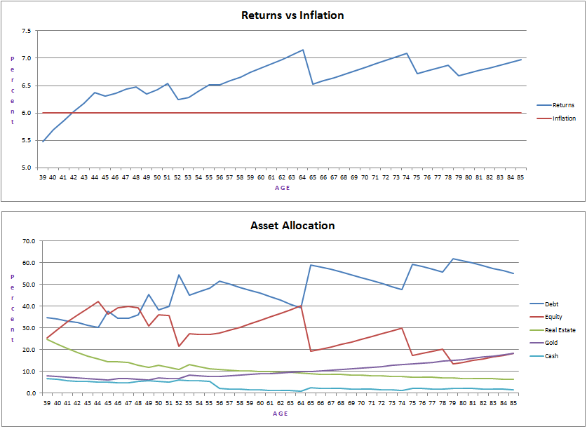
Sample Retirement Plan - Details

Slide 20
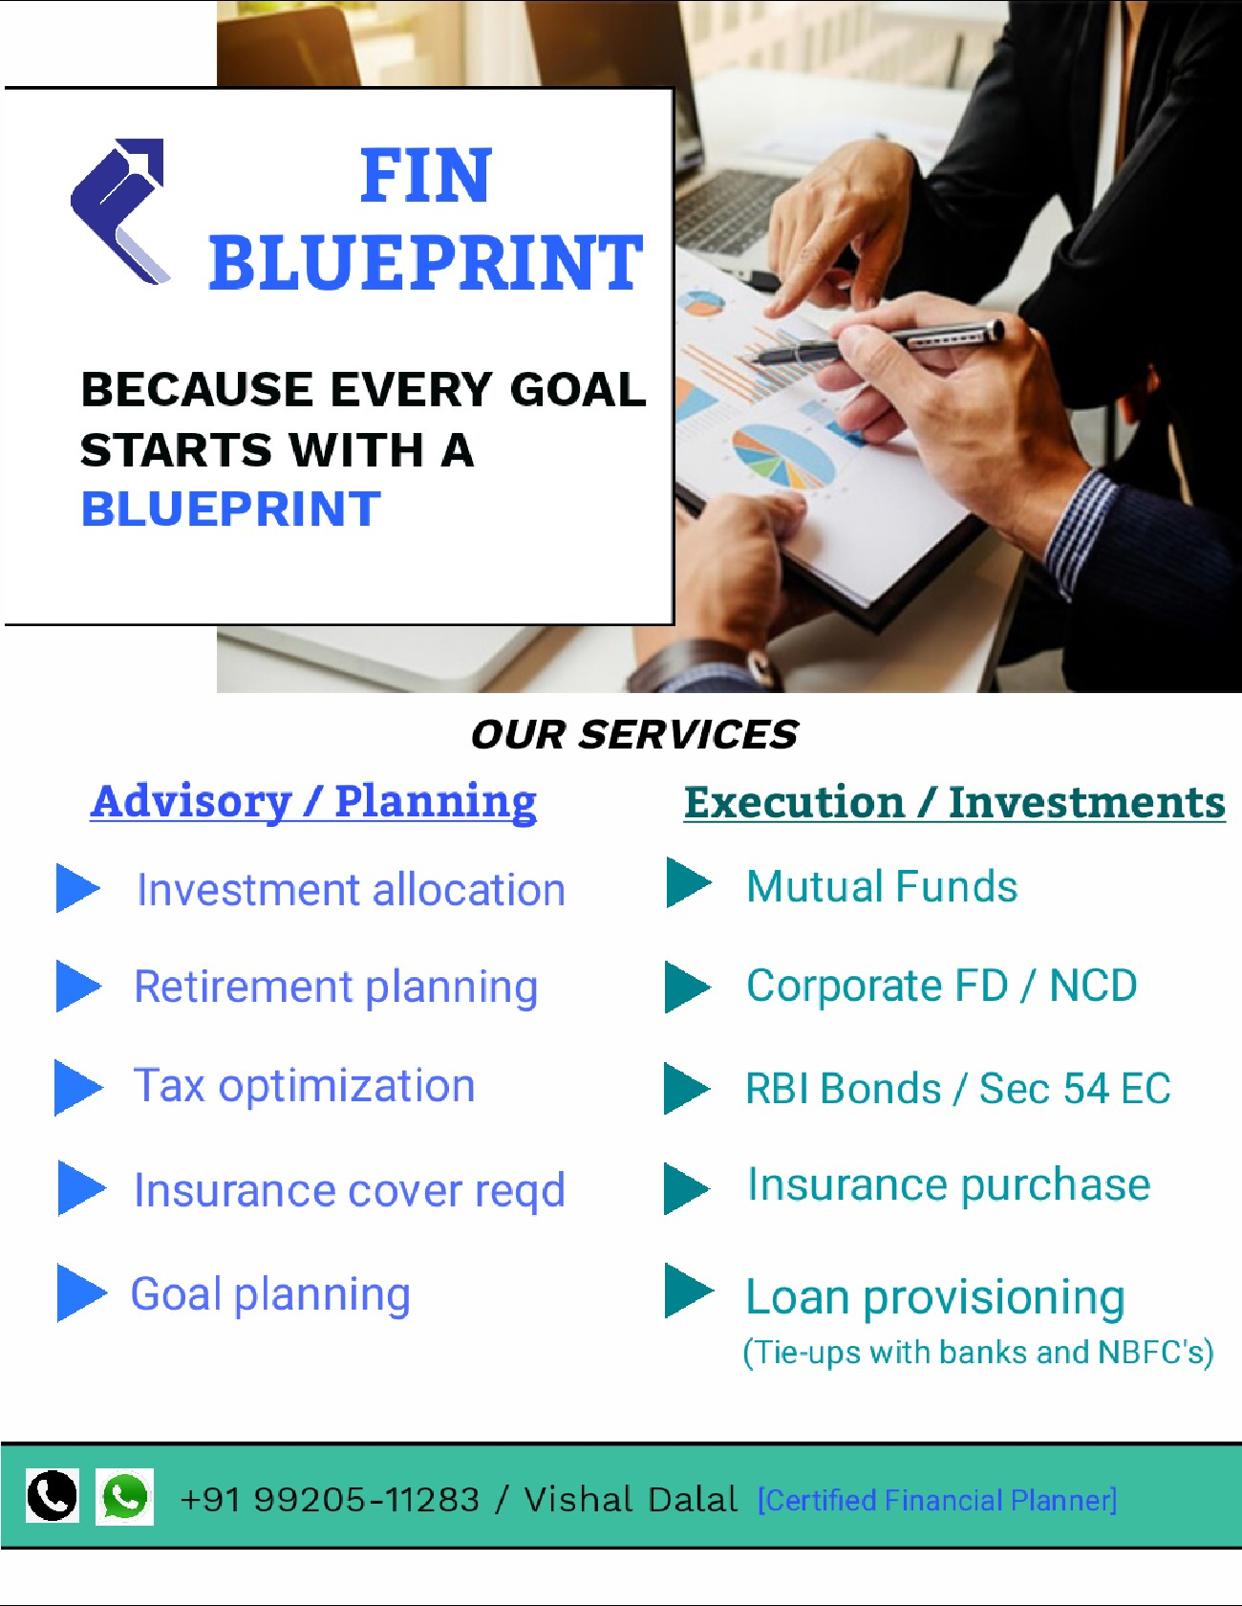
THANK YOU!
Website: www.finblueprint.in
Whatsapp Group: Join

